Slide 1
Objectives
In this session, you will learn to:
  Use variables, operators, and control structures
  Implement functions

Slide 2
Using Loop Constructs
Loop structures are used to execute one or more lines of code repeatedly.
In JavaScript, the following loop structures can be used:
  The while loop
  The do...while loop
  The for loop

Slide 3

Using Loop Constructs (Contd.)
The while loop:
  Is used to execute a block of statements repeatedly till a condition evaluates to true.
  Syntax:
  while (expression)
  {
  statements;
  }

Slide 4
Using Loop Constructs (Contd.)
The do...while loop:
  Executes the statements at least once, in contrast to the while loop.
  Syntax:
  do
  {
  Statements;
  }

Slide 5
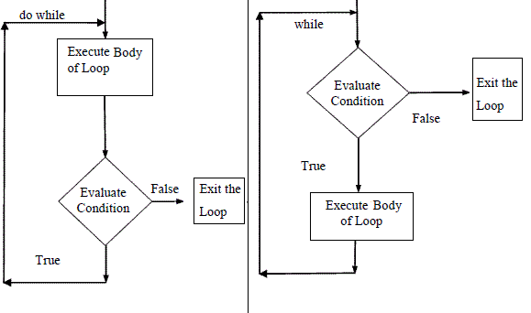
Using Loop Constructs (Contd.)
The difference between the functioning of the do...while and while loop constructs is shown in the following figure.

Slide 6
Using Loop Constructs (Contd.)
The for loop:
  Allows execution of a block of code depending on the result of evaluating the test condition.
  Syntax:
  for (initialize variable; test condition; step value)
  {
  code block
  }

Slide 7
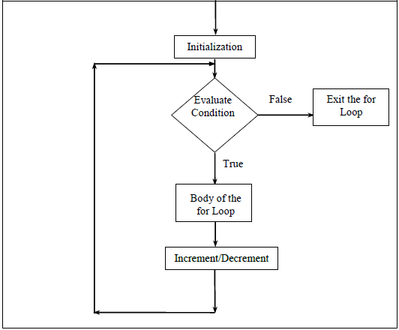
Using Loop Constructs (Contd.)
The sequence of execution for the for loop is shown in the following figure.

Slide 8
Break and Continue Statements
The break statement:
  Is used to exit from the loop.
  Prevents execution of the remaining statements of the loop.
  Syntax:
  while(test condition)
  {
  statement1;
  if (test condition1)
  {
  break;
  }
  Statement2;
  Statement3;
  }
The continue statement is used to skip all the subsequent instructions and take the control back to the loop.

Slide 9
Implementing Functions
The functions enables you to write the code only once and use it whenever required.
The functions are used to optimize the performance by implementing the concept of reusability.

Slide 10
Introducing Functions
A function is a self-contained block of statements that has a name.
Functions can be executed whenever the same computation is required to be performed repeatedly or at different locations in a script.
Functions in JavaScript are of the following types:
  Built-in functions
  User-defined functions

Slide 11
Introducing Functions (Contd.)
Built-in functions are already coded and ready to use within the script tag.
Some of the built-in functions supported by JavaScript are:
  isNaN()
  parseInt()
  parseFloat()
  eval()
  prompt()
  confirm()
  JavaScript enables you to define your own functions according to your needs.
  You can achieve this functionality by creating a user-defined function.

Slide 12
Creating Functions
Functions are created by using the keyword, function, followed by the function name and parentheses().
The following syntax is used to create functions inside the script tag:
function [functionName] (Variable1, Variable2)
{
//function statements
}

Slide 13
Accessing functions
Once you have created a function, you can call it from any portion of the code where you want to use the functionality provided by the function.
The following syntax is used for accessing a function:
functionName ();
While calling a function, you can also pass a variable or value to it.
The variable or value passed to a function is known as a parameter.
The following syntax is used for specifying parameters in a function:
functionName (parameter1, parameter 2...);

Slide 14
Accessing functions (Contd.)
A function can return a value through a return statement.
The following code illustrates how to return a value from a function:
function functionName()
{
var variable=10;
return variable;
}

Slide 15
Summary
In this session, you learned that:
  Loop structures are used to execute one or more lines of code repeatedly.
  In JavaScript, the following loop structures can be used:
    The while loop
    The do...while loop
    The for loop
  The while loop is used to execute a block of statements repeatedly till a condition evaluates to true.
  The for loop allows execution of a block of code depending on the result of evaluating the test condition.
  The statements within the do...while loop are executed at least once, in contrast to the while loop, where the statements in the block are not executed when the condition evaluates to false. The break statement is used to exit from the loop.

Slide 16
Summary (Contd.)
  The continue statement is used to skip all the subsequent instructions and take the control back to the loop.
  A function is a self-contained block of statements that has a name.
  Some features of functions are:
    Reusability
    Modularity
    Overall simplicity
  Functions in JavaScript are of the following types:
    Built-in functions
    User-defined functions
  Built-in functions are already coded and ready to use.
  Functions are created by using the keyword, function, followed by the function name and parentheses().

Slide 17
Summary (Contd.)
  Functions can be called from any portion of the code where you want to use their functionality.

